Slide 1

ABV & IBU: Exploration of Beers
MSDS Consulting Group
Jae Chung
Notes:
Slide 1 (intro slide) ( approximately 50 seconds)
Hello Brendan and Ricardo,
Today, I wanted to present to you my findings on the ABV & IBU Exploration of Beers. My name is Jae Chung, and I’m a Data Scientist who wants to help companies prosper . As you know, the beer industry is a rapidly evolving market. At the MSDS Consulting group, we specialize in leveraging data science to help companies make more informed decisions, drive innovation, and stay ahead of their industry competitors. Today, I'd like to share some insights we've gathered from a year’s worth of analysis.

Slide 2

Breweries by State
States with Most Breweries
States with Least Breweries
Colorado – 47
California – 39
Michigan – 32
Oregon – 29
Texas – 28
AL, KS, NH, NJ, TN – 3
AR, DE, MS, NV – 2
DC, ND, SD, WV – 1
11
Mean number of Breweries for US States overall
Notes:
Slide 2 ( approximately 18 seconds)
First, we looked at how many breweries were present in each state. In the past year, we found that the average number of breweries for all US states was 11. Here, we can see the states with the most and least breweries and where Budweiser’s market segments could be focused on.

Slide 3
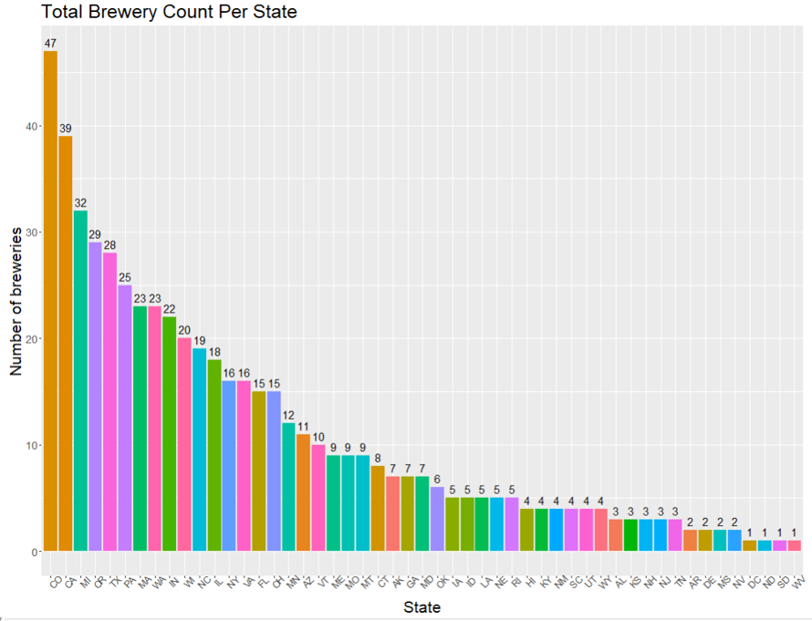
Bar Plot of Breweries by State
Notes:
Slide 3 ( approximately 50 seconds)
We can see that Colorado has the highest number of breweries, with 47, followed by California with 39. On the other hand, we can see that DC, North Dakota, South Dakota, and West Virginia, had the lowest number of breweries with 1 respectively. It's interesting to note that many of these states have smaller populations and may not have as much demand for beer as other states, which could explain the lower number of breweries. Overall, this plot can be helpful in informing decision-making around market expansion, distribution, and branding strategies.

Slide 4
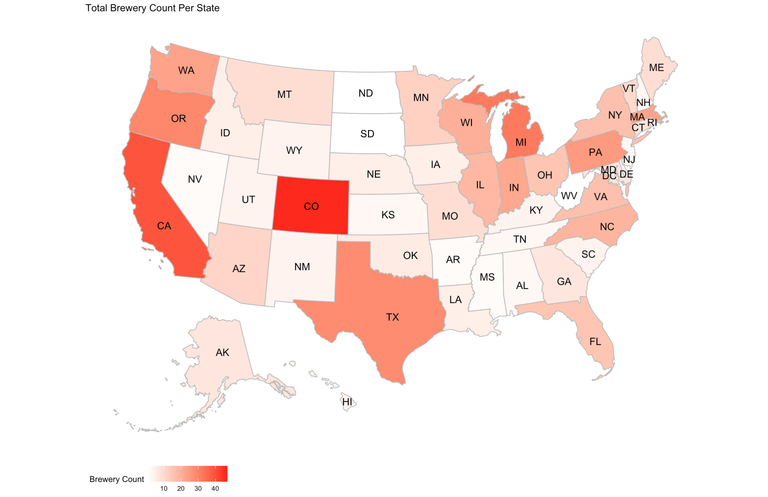

Colorado has the Most Breweries!
Notes:
Slide 4 ( approximately 50 seconds)
This map plot provides a great overview of the distribution of breweries across the US. It allows us to see patterns and trends in the data, which may not be immediately apparent from looking at raw data alone. This information can be useful identifying potential opportunities for growth by geographic location. Just from a glance, we can clearly see Colorado has the highest number of breweries with the darkest shade of red.

Slide 5
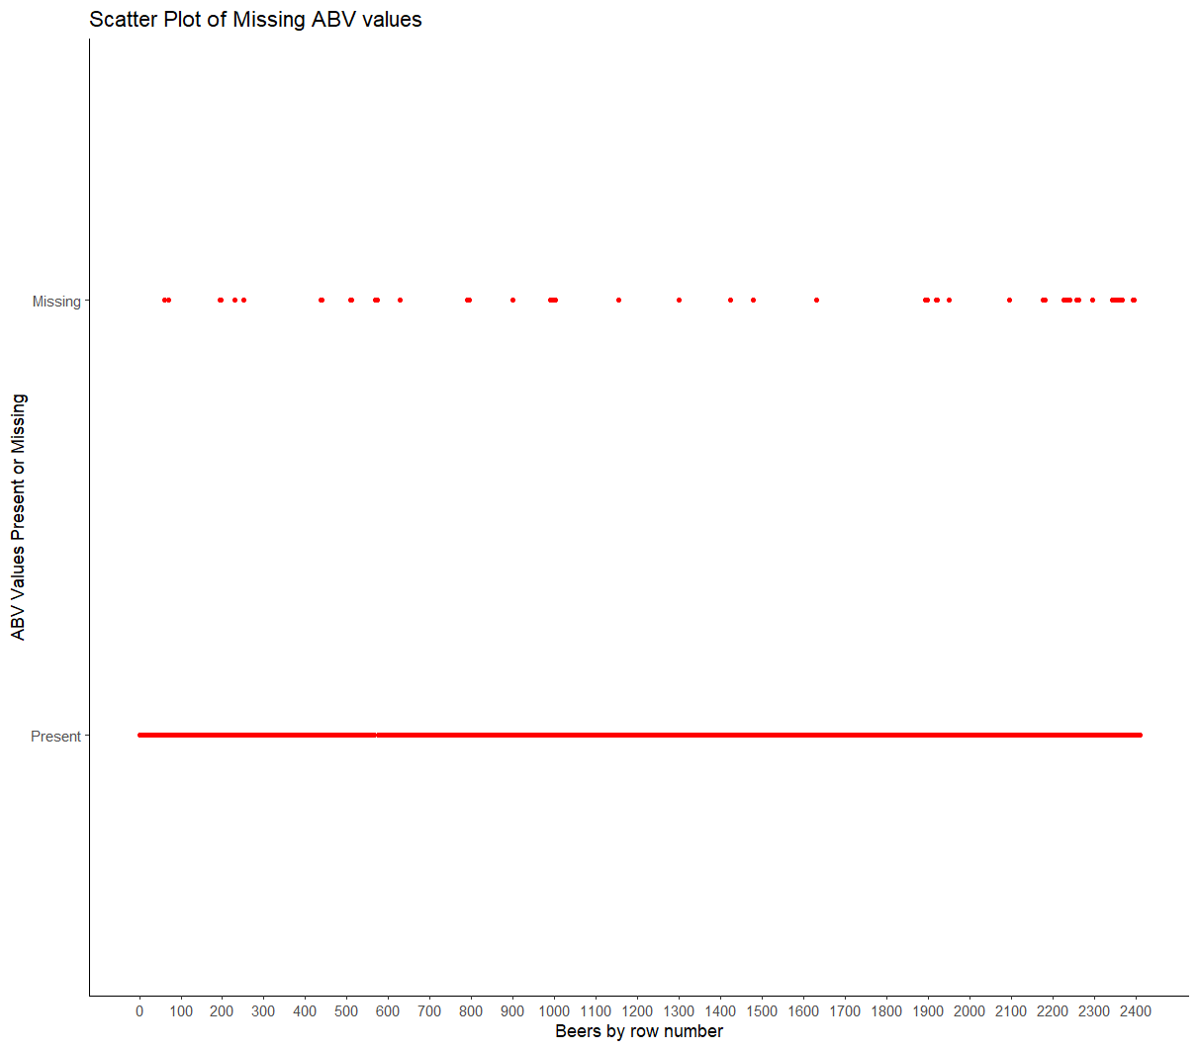
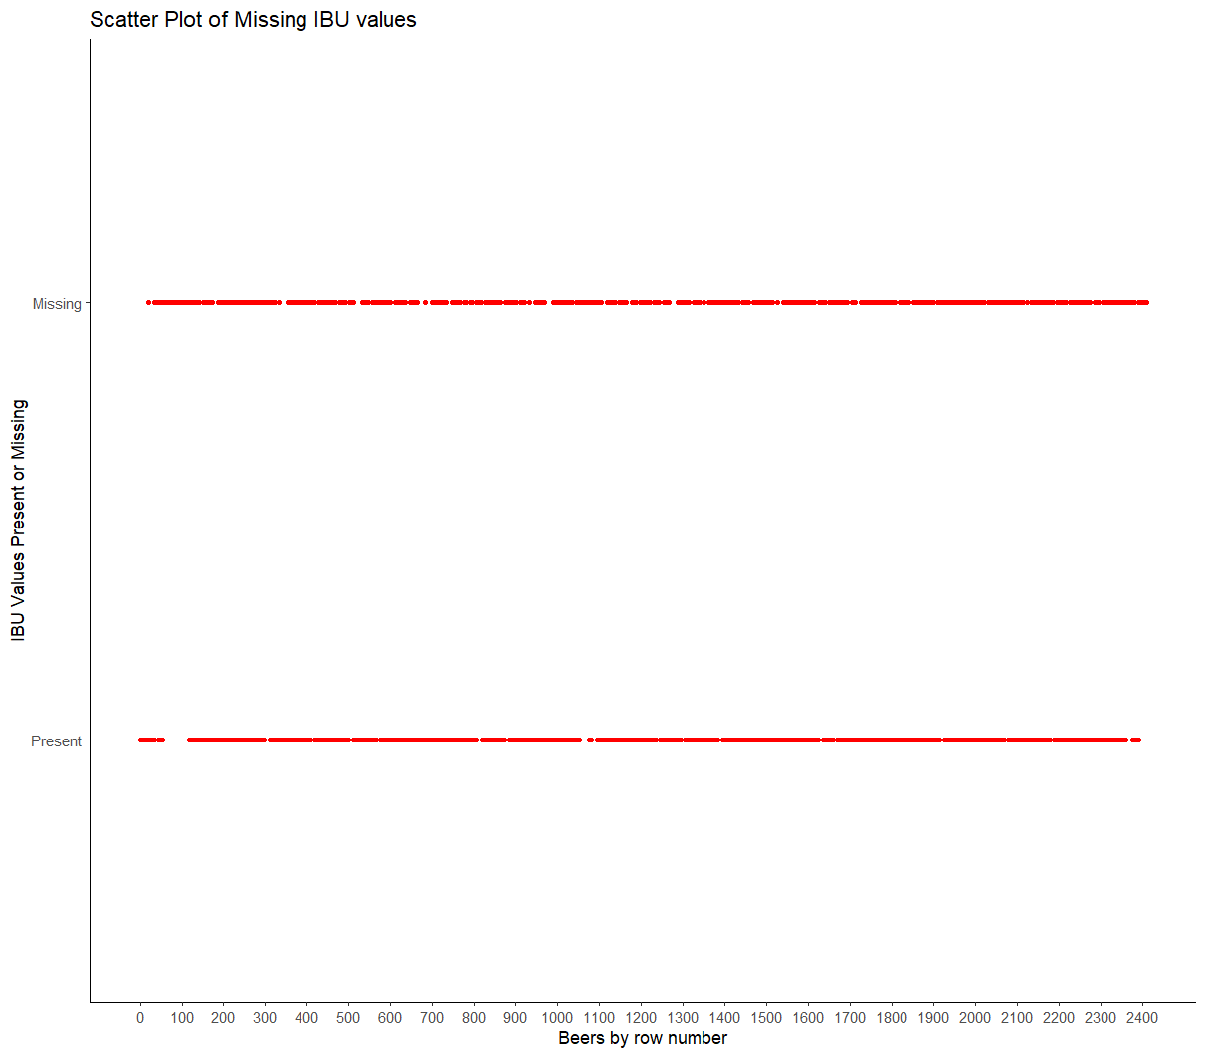
Is the Data MCAR?
ABV Missing Data
IBU Missing Data
Notes:
Slide 5 ( approximately 45 seconds)
Is the Data Missing Completely at Random?
We addressed the missing values found in each column of our data. Specifically, we found that there were some missing values in the ABV and IBU columns for quite a few beers across different breweries. So, we wanted to get an idea as to how randomly these data points were spread across the dataset.

Slide 6

Notes:
Slide 6 ( approximately 20 seconds)
We can see how the missing ABV values are spread out over the many existing ones in this dataset. This gives us confidence that suggests the data is missing completely at random, so we felt it wasn’t necessary to include those missing values in our analysis.

Slide 7
Notes:
Slide 7 ( approximately 67 seconds)
We plotted the missing IBU values alongside the existing values, and the scatter plot showed that the missing values were spread out randomly across the entire dataset. This was good news, because if the missing values were systematic, it could indicate errors in the data collection process, but the random distribution suggested that the missing values were due to chance and not related to any specific variables such as style, state location, or the dataset itself.

Slide 8
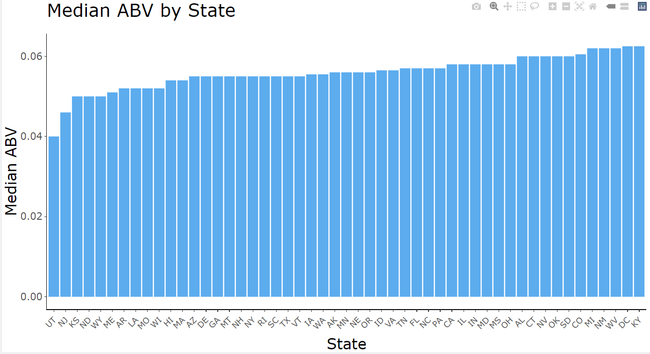
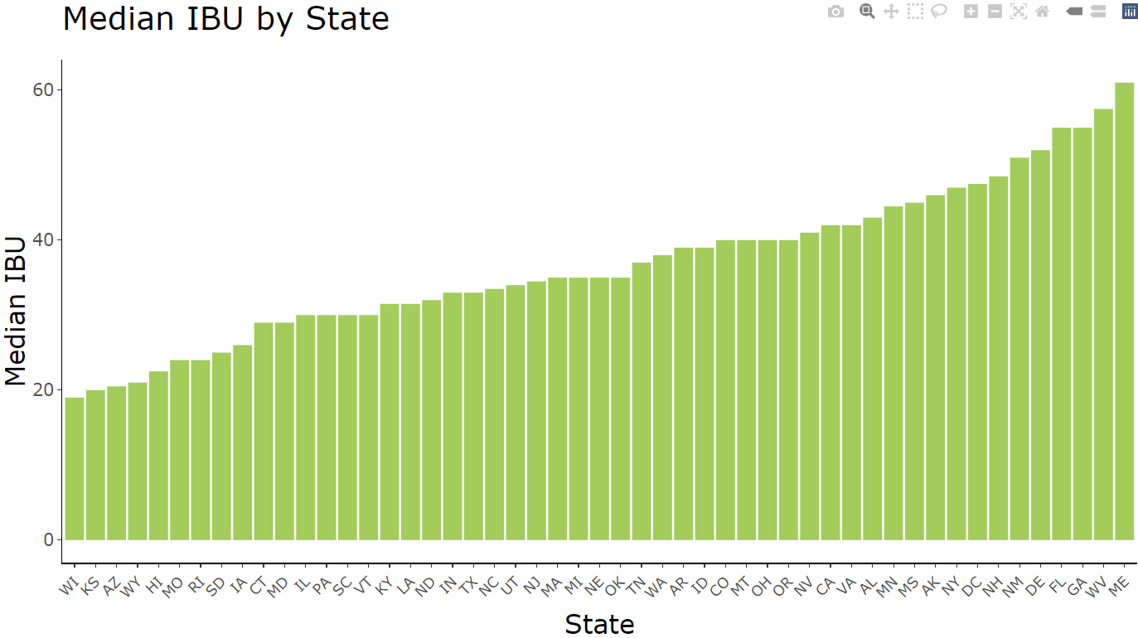
ABV & IBU by State
Median ABV by State
Median IBU by State
Notes:
Slide 8 ( approximately 50 seconds)
Moving on, we computed the median Alcohol By Volume or ABV measuring the alcoholic content of the beer and the International Bitterness Units or IBU measuring the bitterness of the beer on a standardized scale from 0 (no bitterness) to over a 100 (extremely bitter).

Slide 9


Median ABV by State
Median ABV
Notes:
Slide 9 ( approximately 16 seconds)
We can observe from this bar plot that Washington DC and Kentucky had the highest median ABV of 6.25%, while Utah had the lowest median ABV of 4%.

Slide 10

Median IBU by State
Notes:
Slide 10 ( approximately 15 seconds)
In terms of IBU, Maine had the highest median IBU of 61, while Wisconsin had the lowest median IBU of 19.

Slide 11
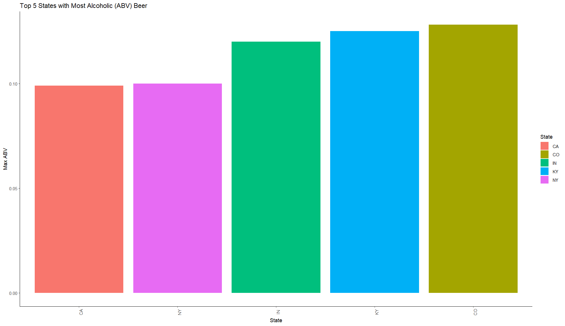
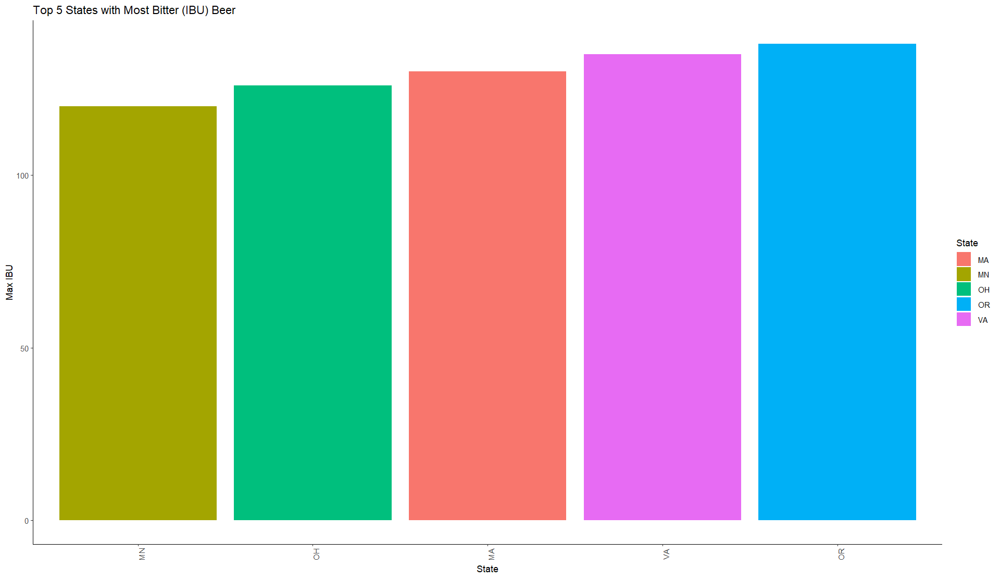
Maximum ABV & IBU by State
Top 5 Maximum ABV by State
Top 5 Maximum IBU by State
Notes:
Slide 11 ( approximately 18 seconds)
Moreover, we found which state had the beers with the highest (ABV) and IBU values.

Slide 12
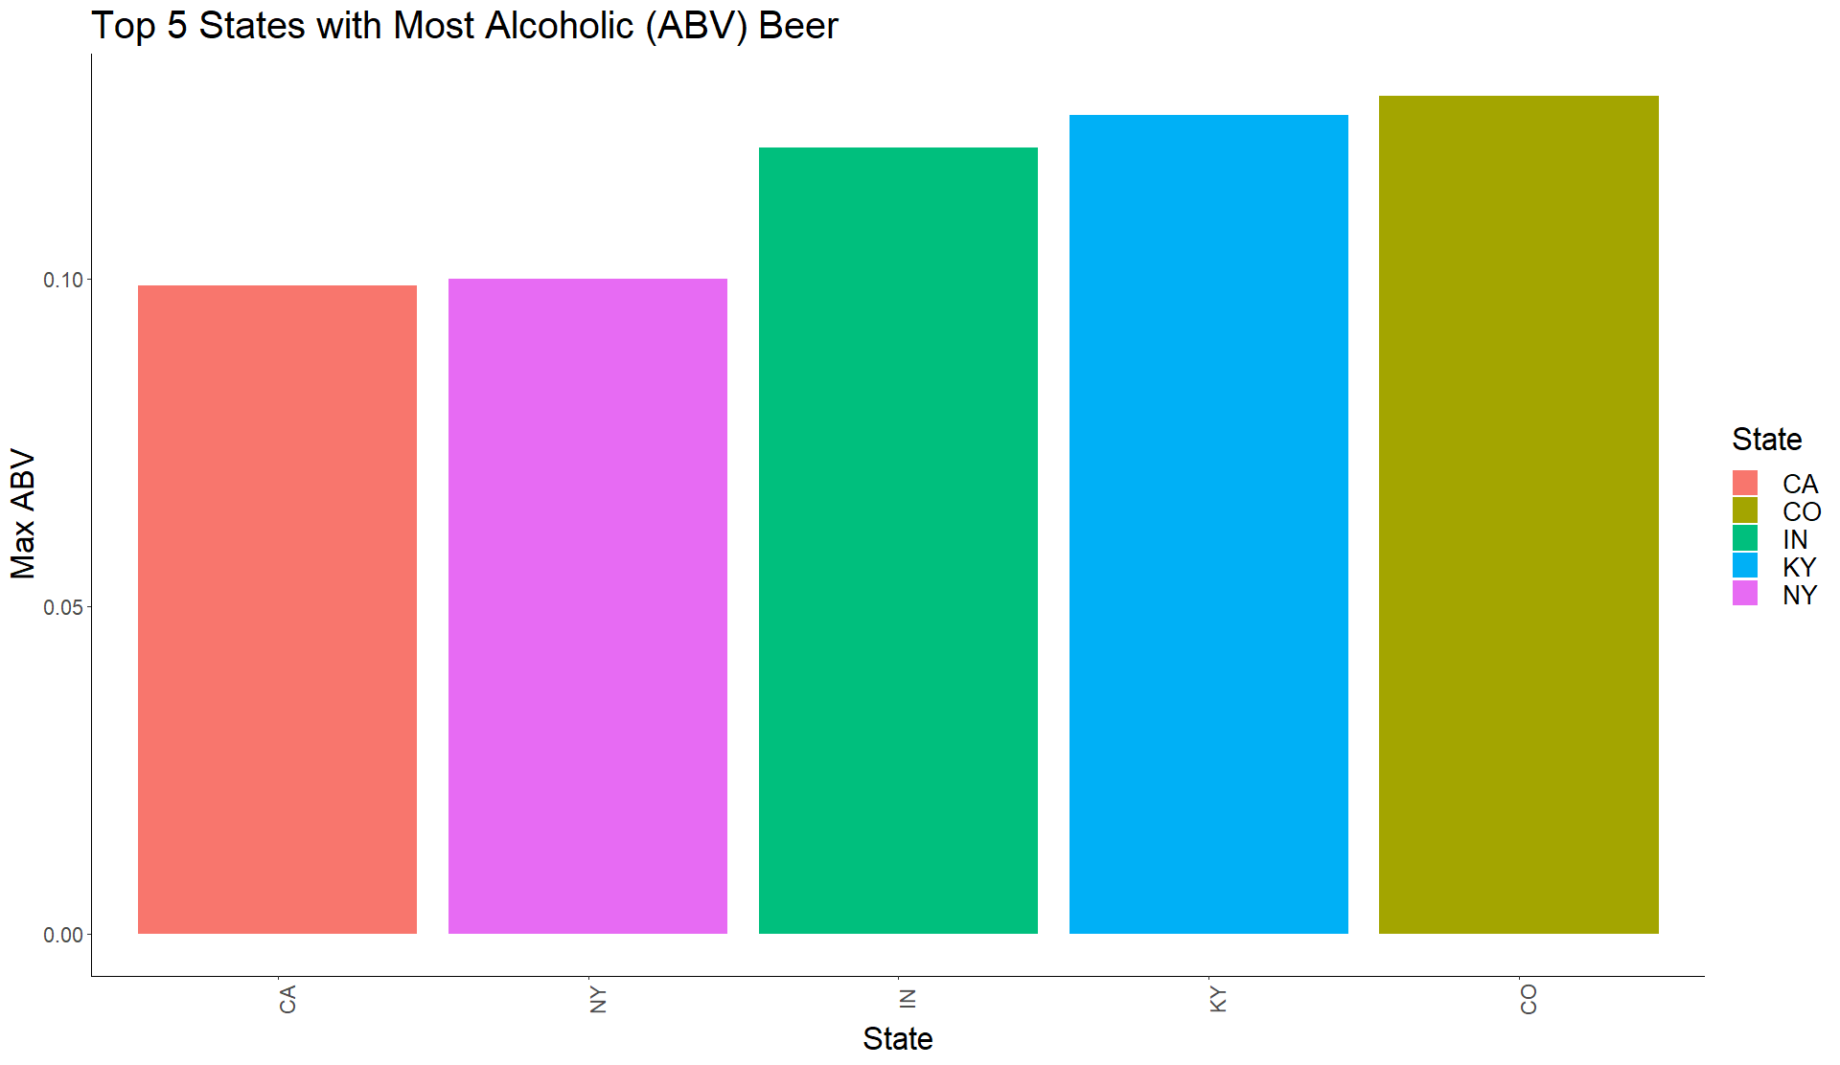
Top 5 Maximum ABV by State
KY
12.5%
CO
12.8%
IN
12%
CA
9.9%
NY
10%
Notes:
Slide 12 ( approximately 11 seconds)
We can see that Colorado takes the number one spot for ABV, with an ABV level of 12.8%.

Slide 13
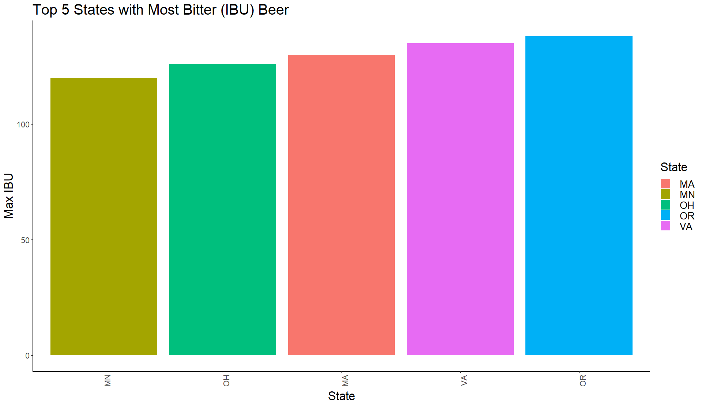
Top 5 Maximum IBU by State
VA 135
OR
138
OH
126
MA
130
MN
120
Notes:
And on the other hand, for the most bitter beers we can see Oregon came out on top, with a whopping IBU score of 138.

Slide 14
Summary Statistics of ABV Data
Minimum | 0%
1st Quarter | 5%
Median | 5.6%
Mean | 5.97%
3rd Quarter | 6.7%
Maximum | 12.8%
Minimum ABV level is 0% for non-alcoholic beer
Maximum ABV level is 12.8%
Median ABV level is 5.6%
Average ABV level is 5.97%
Notes:
Here we can see a table of the summary statistics showcasing some interesting metrics.
We can see that the minimum ABV level was 0% for non-alcoholic beers, there was a maximum ABV level of 12.8%, a Median ABV level of 5.6% and a Mean ABV level of 5.97%.

Slide 15
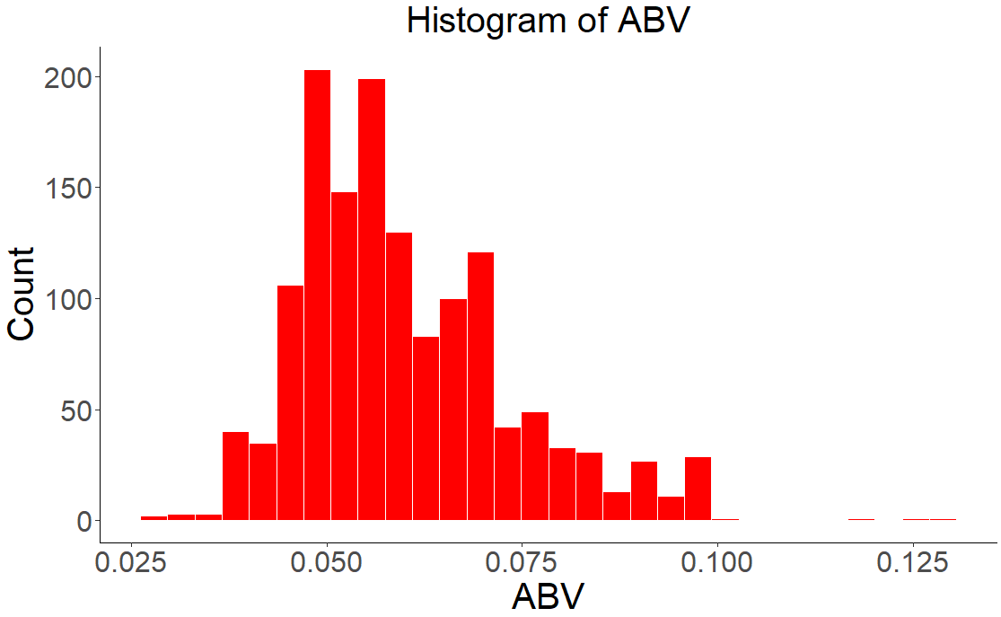
ABV Distribution
Notes:
Slide 15 ( approximately 55 seconds)
Here we see a histogram of the ABV values, many of which fell in the 4-7% range. Notice the histogram is roughly symmetric except for the long right tail, which indicates that there are some outlying beers with high ABV values. In general, the ABV variable shows a reasonable range and distribution of values for beer, with most of the beers having a relatively moderate alcohol content.

Slide 16
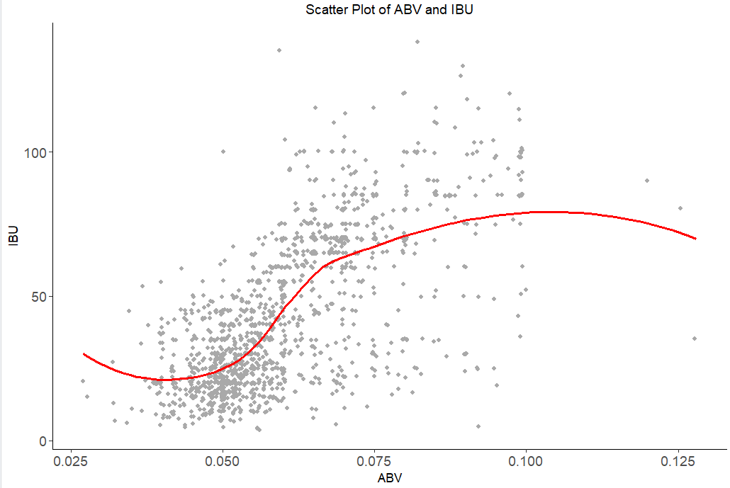
Relationship of ABV vs. IBU
Notes:
Slide 16 ( approximately 69 seconds)
Now we explored if there was an apparent relationship between the bitterness of the beer and its alcoholic content. The gray dots represent individual beers, and the red line represents a smoothed curve fit of the data.
Generally, as the alcoholic content of beer increases, so does its bitterness. There appears to be a slight positive relationship associated between ABV and IBU levels, but we can see an eventual downward trend due to an outlier that has a high ABV but lower IBU.
Throughout the scatter plot, we can see lots of variability and dispersion of the dots. This suggests that while there is some relationship associated between ABV and IBU, other factors such as the type of beer, brewing methods, and ingredient choices can also influence the bitterness of a beer.

Slide 17
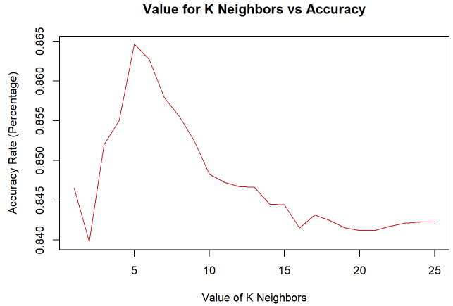
Finding the best K value
Notes:
Slide 17 ( approximately ? seconds)
Furthermore, we wanted to identify whether there was a relationship between a beer's ABV and IBU values and its classification as an IPA or Ale. To answer this question, we used a machine learning technique called K-Nearest Neighbors or KNN to classify beers as either an IPA or Ale based on their ABV and IBU values. To do this, we first ran this analysis multiple times with different training and testing data sets and different values of k, k being the number of nearest neighbors used in the classification. Here we happened to see our best k value is 5 with an accuracy rate around 86%.

Slide 18
Confusion Matrix and Statistics
 | Predicted Class
Actual Class | Classifications | Ale | IPA
 | Ale | 133 | 13
 | IPA | 31 | 108
Accuracy = 0.8456
Notes:
Slide 18 ( approximately ? seconds)
The confusion matrix here is a two by two table that summarizes the performance of a classification model by comparing its predictions to the actual labels in a test dataset. In this table, the rows correspond to the actual classifications and the columns correspond to the predicted classifications. With Ale being the positive classification and IPA being the negative classification, we can see that 133 beers were correctly classified as an Ale, and 108 beers were correctly classified as an IPA. We can observe that the results of this confusion matrix accurately classifies a beer as an ALE or IPA with an 84 percent accuracy rate providing some confidence in the KNN’s ability to classify these beers.

Slide 19
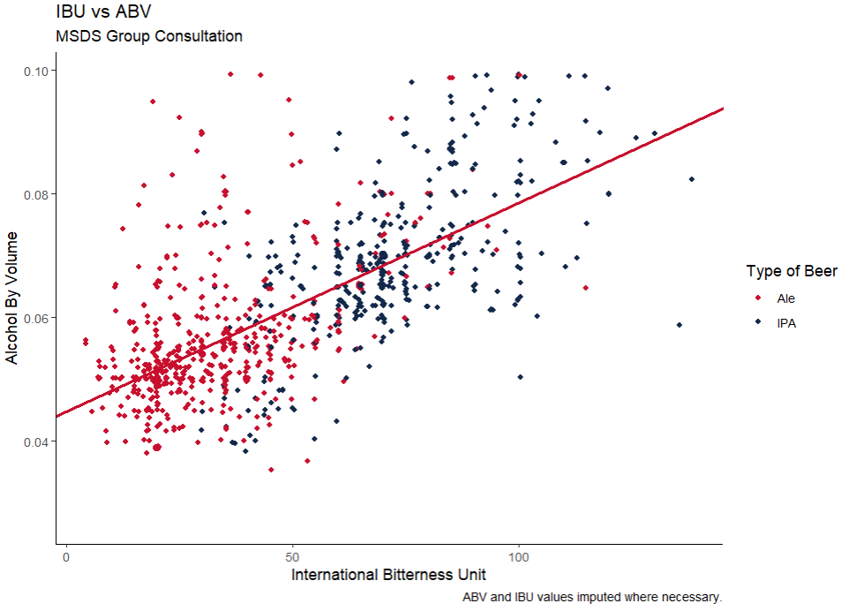
Linear Correlation Model
Notes:
Slide 19 ( approximately ? seconds)
The straight line is called a decision boundary and it separates the different types of beers based on their ABV and IBU values. The KNN model uses this boundary to classify new beers as either Ales or IPAs, and in general, we can see that IPAs tend to have higher IBU and ABV ranges, but there seems to also be some overlap between the two groups. The decision boundary is set in such a way as to maximize the accuracy of the KNN model in classifying the beers

Slide 20
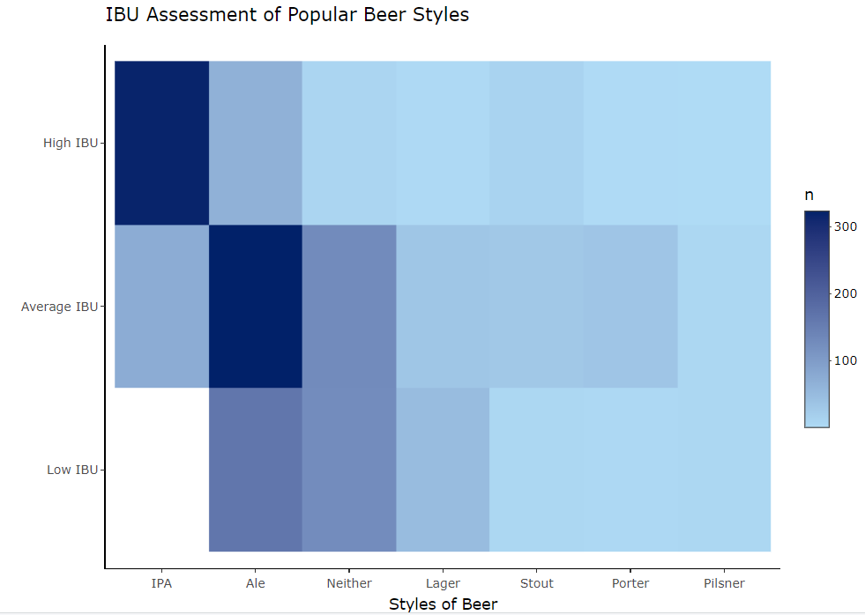
IBU Assessment of Popular Beer Styles
Notes:
Slide 21
We can infer from this heat map that Budweiser could adjust their beer offerings to include more IPAs, particularly those with high IBU values, to meet customer demand and capitalize on this popular beer style.

Slide 21
Conclusion
In general IPAs are more bitter than ALEs
In general IPAs have higher ABVs than ALEs
but there still seems to be overlap of these characteristics between these two types of beers.
Notes:
Slide 22 ( approximately ? seconds)
In general IPAs have Higher ABVs and IBUs than ALEs, but sometimes there is also an overlap of these characteristics. Budweiser could potentially design new beers based on these characteristics and classify their beers as IPAs or ALEs and market these in states or regions where the demand is high for these styles. I hope this information is useful in your decision-making processes.

Slide 22
Thank you
MSDS Consulting Group
Jae Chung
Email: jgchung@smu.edu
Notes:
Ending Slide
Thank you again for blocking some time for this presentation. Again, my name is Jae Chung representing the MSDS Consulting Group and I hope you found today’s presentation informative and engaging.
If you have any further questions or would like to discuss the topics covered in more detail, please don't hesitate to reach out to me via email.
Thank you again for your time and attention.

Slide 23
Thank you
Link to the video:
https://youtu.be/lceT7NSXcrY
Notes:
Ending Slide
Thank you again for blocking some time for this presentation. Again, my name is Jae Chung representing the MSDS Consulting Group and I hope you found today’s presentation informative and engaging.
If you have any further questions or would like to discuss the topics covered in more detail, please don't hesitate to reach out to me via email.
Thank you again for your time and attention.

